Slide 1
Transactions

Slide 2
What is a Transaction?
A transaction is a sequence of one or more SQL operations (such as INSERT, UPDATE, or DELETE) that are executed as a single unit.
Transactions ensure that the database remains in a consistent state, even when something goes wrong (like a system failure).

Slide 3
ACID principles:
Atomicity: All operations within a transaction are treated as a single unit. If one part of the transaction fails, the entire transaction fails, and the database remains unchanged.
Consistency: Transactions move the database from one valid state to another, maintaining database integrity.
Isolation: Transactions are isolated from each other. Changes made in one transaction are not visible to other transactions until the transaction is committed.
Durability: Once a transaction is committed, its changes are permanent and persist even if there is a system failure.

Slide 4
Using BEGIN and COMMIT
BEGIN: This marks the start of a transaction. All the operations performed between BEGIN and COMMIT are part of the transaction.
COMMIT: This confirms the transaction, applying all the changes permanently to the database.

Slide 5
Example
Let’s say you have two accounts, and you want to transfer money from one account to another. You need to deduct money from one account and add it to the other. Both actions should succeed or fail together; otherwise, the accounts may become inconsistent (e.g., if the money is deducted from one account but not added to the other).
Допустим, у вас два счета, и вы хотите перевести деньги с одного счета на другой. Вам нужно списать деньги с одного счета и добавить их на другой. Оба действия должны быть успешными или неудачными одновременно; в противном случае счета могут стать несогласованными (например, если деньги будут списаны с одного счета, но не будут переведены на другой).

Slide 6
Code Example
Explanation:
The transaction starts with BEGIN.
The balance is deducted from account_id = 1.
The balance is added to account_id = 2.
Finally, COMMIT ensures that both operations are successfully applied.
BEGIN;
UPDATE accounts
SET balance = balance - 100
WHERE account_id = 1;
UPDATE accounts
SET balance = balance + 100
WHERE account_id = 2;
COMMIT;
Объяснение:
Транзакция начинается с команды
BEGIN.
Баланс вычитается из account_id = 1.
Баланс добавляется к account_id = 2.
Наконец,
COMMIT гарантирует, что обе операции будут успешно применены.

Slide 7
What Happens if Something Goes Wrong? ROLLBACK
If something goes wrong during the transaction (e.g., an error occurs in one of the UPDATE statements), you can issue a ROLLBACK command to undo all the changes made since the BEGIN. This way, the database remains consistent.
Если во время транзакции что-то пойдет не так (например, произойдет ошибка в одной из инструкций UPDATE), вы можете выполнить команду отката, чтобы отменить все изменения, внесенные с самого НАЧАЛА. Таким образом, база данных останется непротиворечивой.

Slide 8
Example of Rollback
BEGIN;
UPDATE accounts
SET balance = balance - 100
WHERE account_id = 1;
-- Suppose something goes wrong here (like an error)
—Предположим, что здесь что-то пошло не так (например, произошла ошибка).
COOMIT
ROLLBACK;

Slide 9
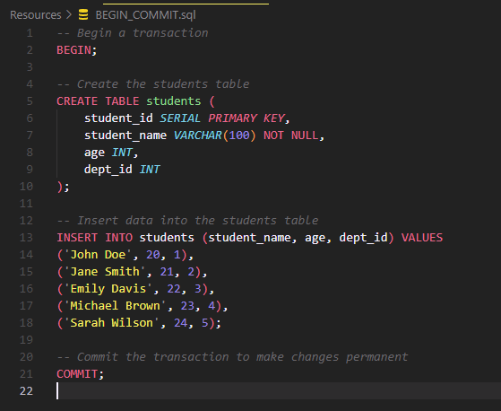
Resources/ BEGIN_COMMIT.sql

